Slide 1

Batch-23
PTU
CODING AND
MONITORING PLATFORM
CAPGEMINI – FULLSTACK PROJECT REVIEW
DONE BY
RITHIKA. M (21CS418)
MCA –II year.

Slide 2
PROBLEM STATEMENT
Creating interest and to practice variety of coding programs to improve problem solving skills for PTU students
Platform to enhance computational and creative thinking
Coding assessments can help students to be better prepared for pre-hiring programming tests

Slide 3
OBJECTIVES
To design and develop a online Coding platform
To enable students to solve logical and technical coding problems with their language of choice
To provide programming assessments validated with pre-defined test cases
To enable faculty to monitor students progress and evaluate their performance based on the assessments

Slide 4
TECHOLOGY STACK
Frontend | Reactjs
Backend | Spring boot
Database | PostgreSQL
ORM Mapping | JPA(Hiberate)
Testing | Junit,Mockito
Code Coverage | Eclemma
Collaboration | Github
Deployment | Docker

Slide 5
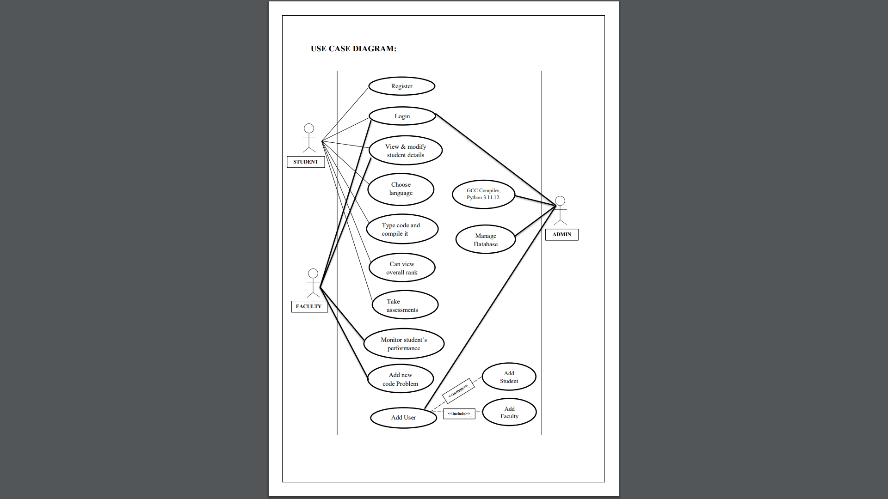
USE CASE DIAGRAM

Slide 6
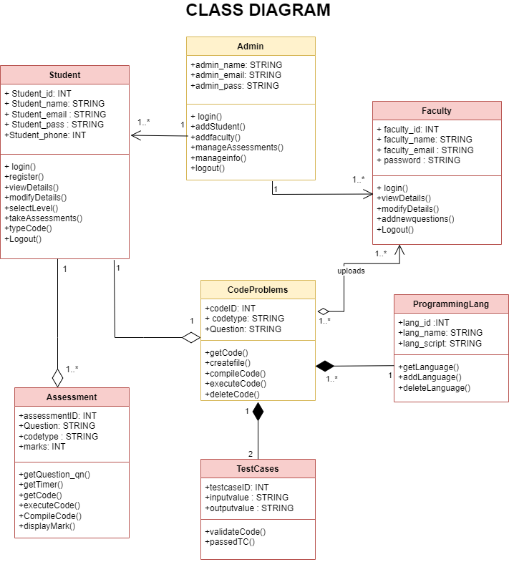
CLASS DIAGRAM

Slide 7
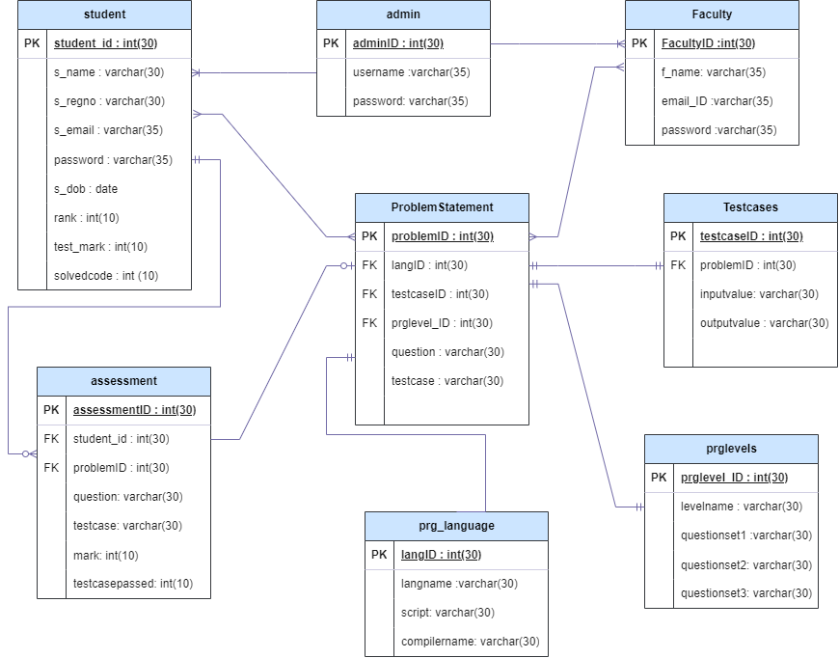
ER DIAGRAM

Slide 8
TESTING FRAMEWORK
USING JUNIT MOCKITO
The tool used for testing is Junit and Mockito
This involved testing the controller, entity, and service layers to ensure robust functionality and reliability for all the microservices
Each microservices are tested with various testcases at every layer.

Slide 9
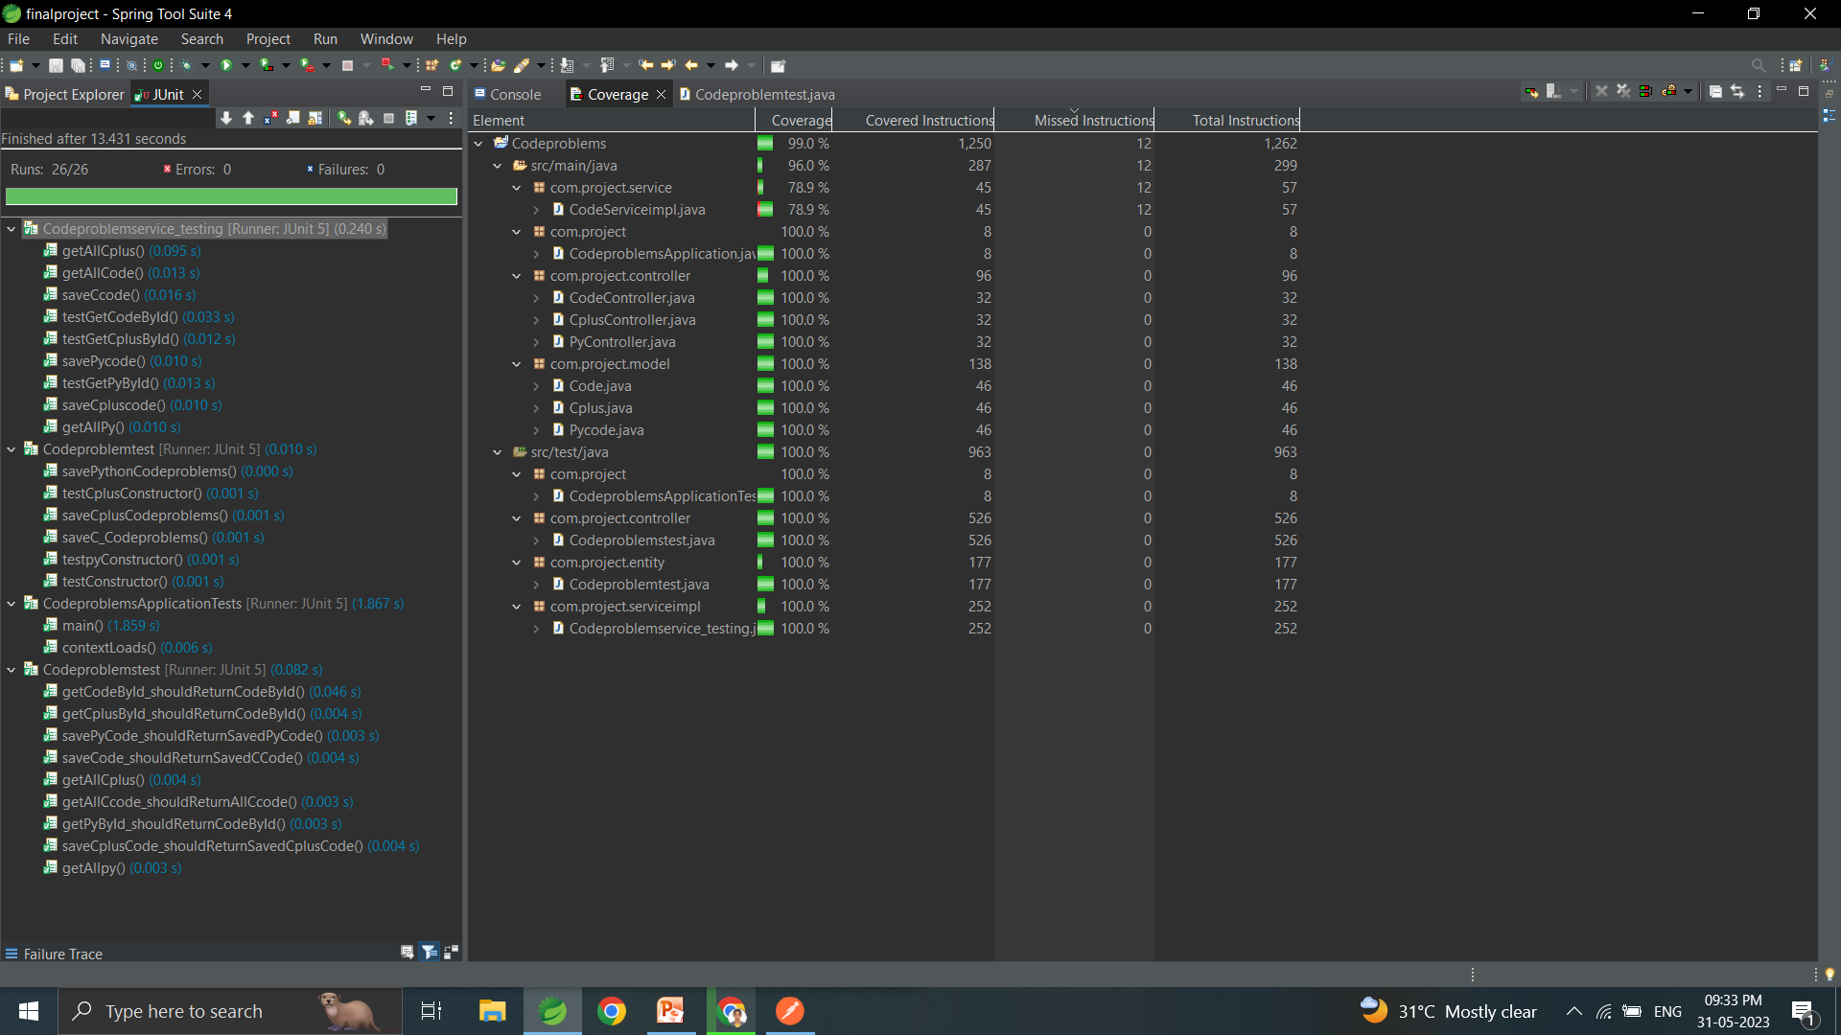
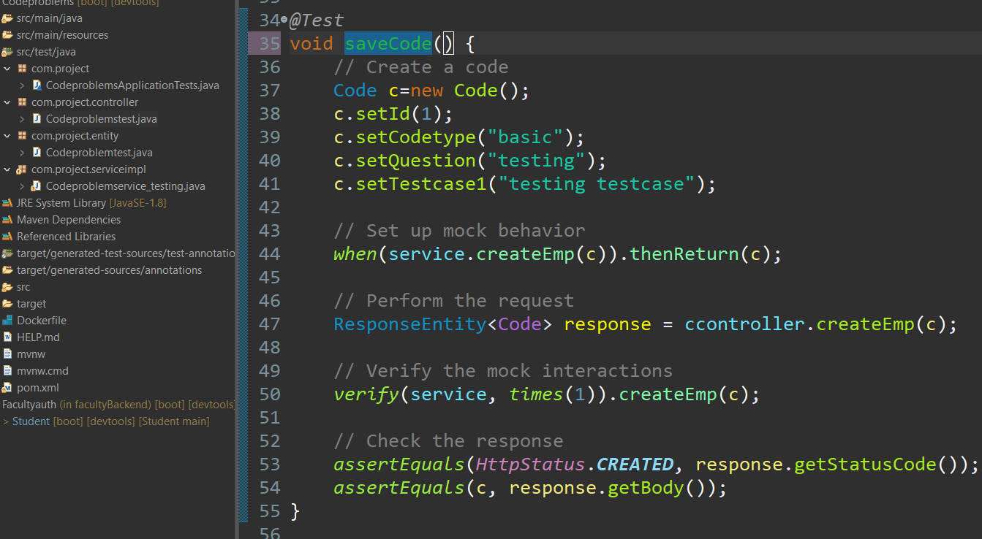
CODEPROBLEM MICROSERVICE TESTING
Total testcases : 26
Testcases passed : 26

Slide 10
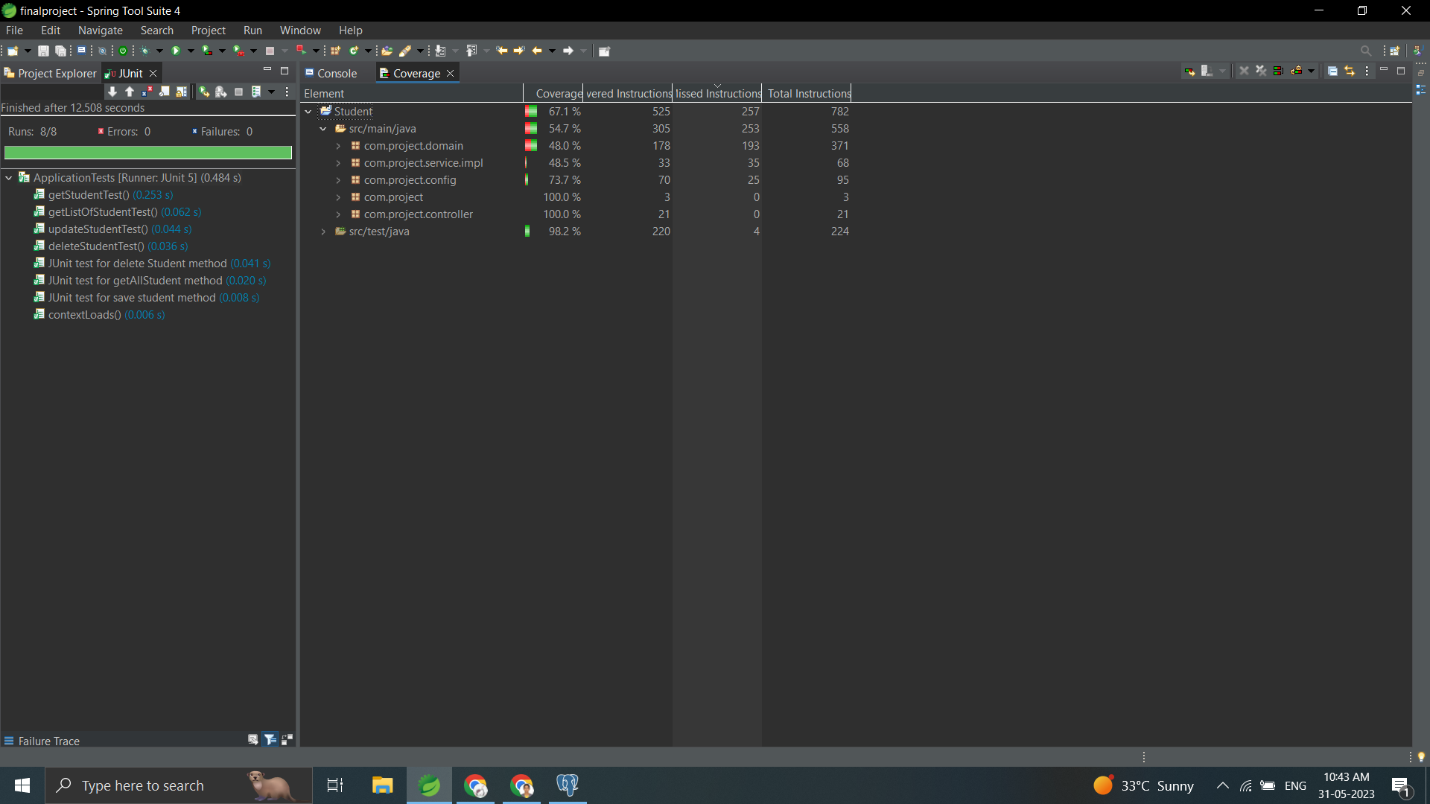
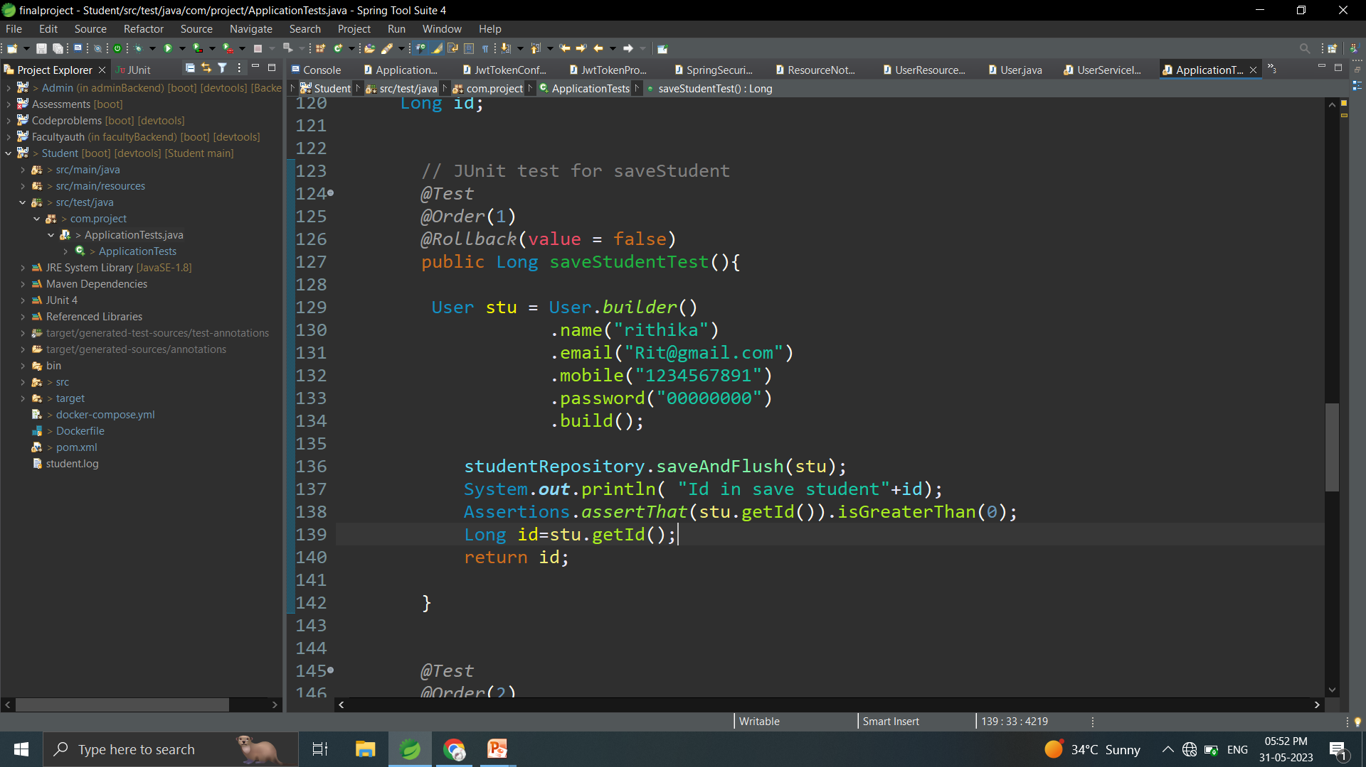
Total testcases : 8
Testcases passed : 8
STUDENT MICROSERVICE TESTING
Testcase :
To save student details
Code:

Slide 11
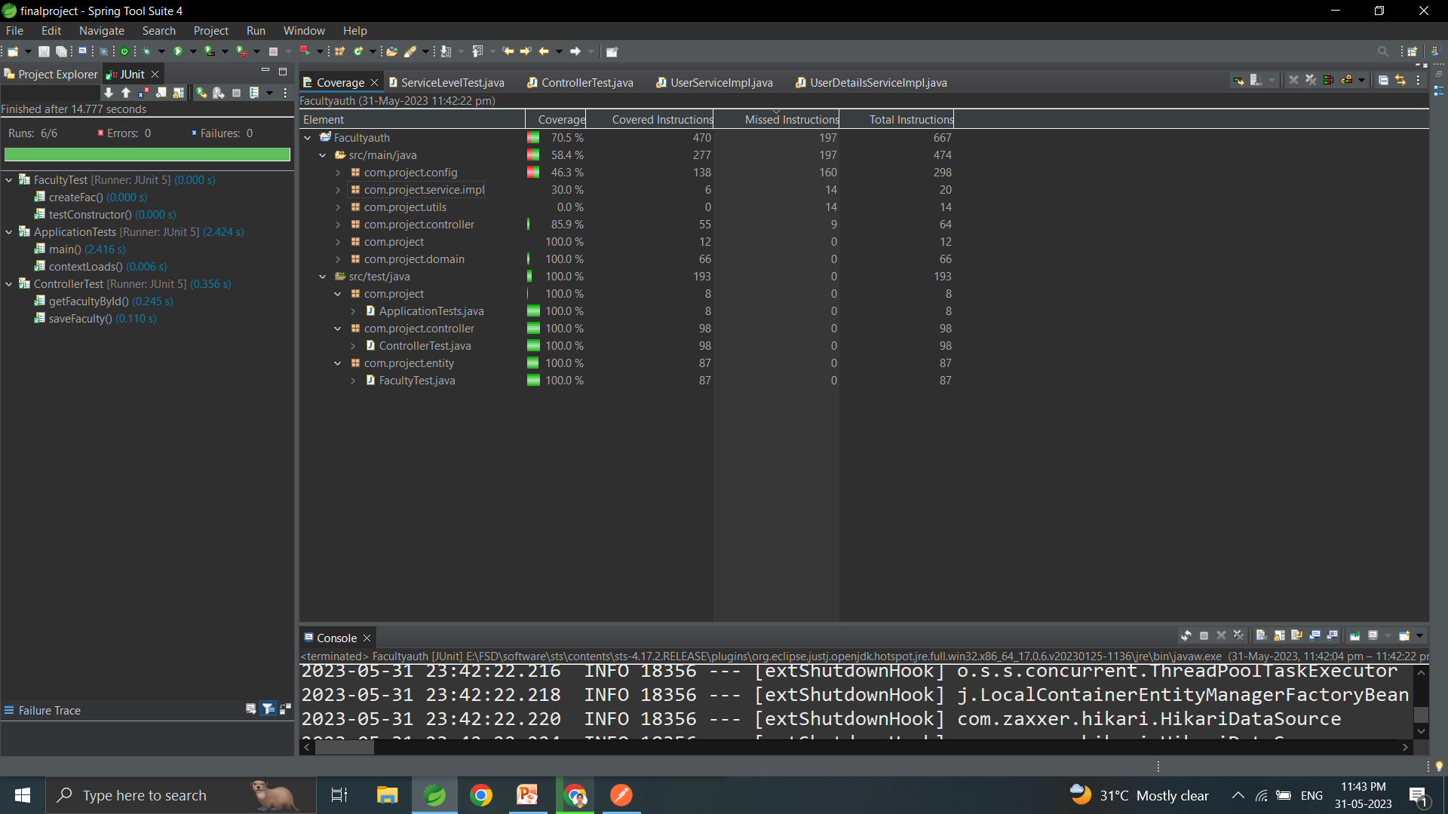
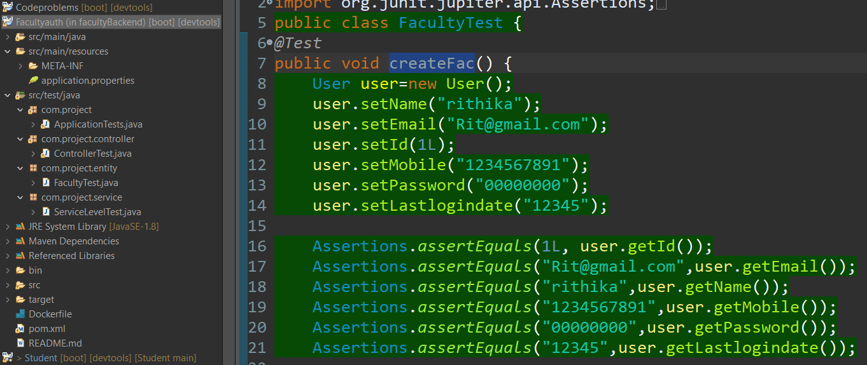
Total testcases : 6
Testcases passed : 6
FACULTY MICROSERVICE TESTING
Testcase:
To add new faculty
Code:

Slide 12
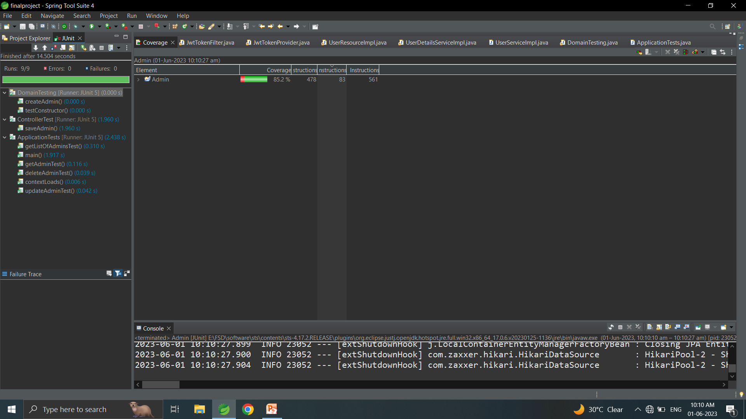
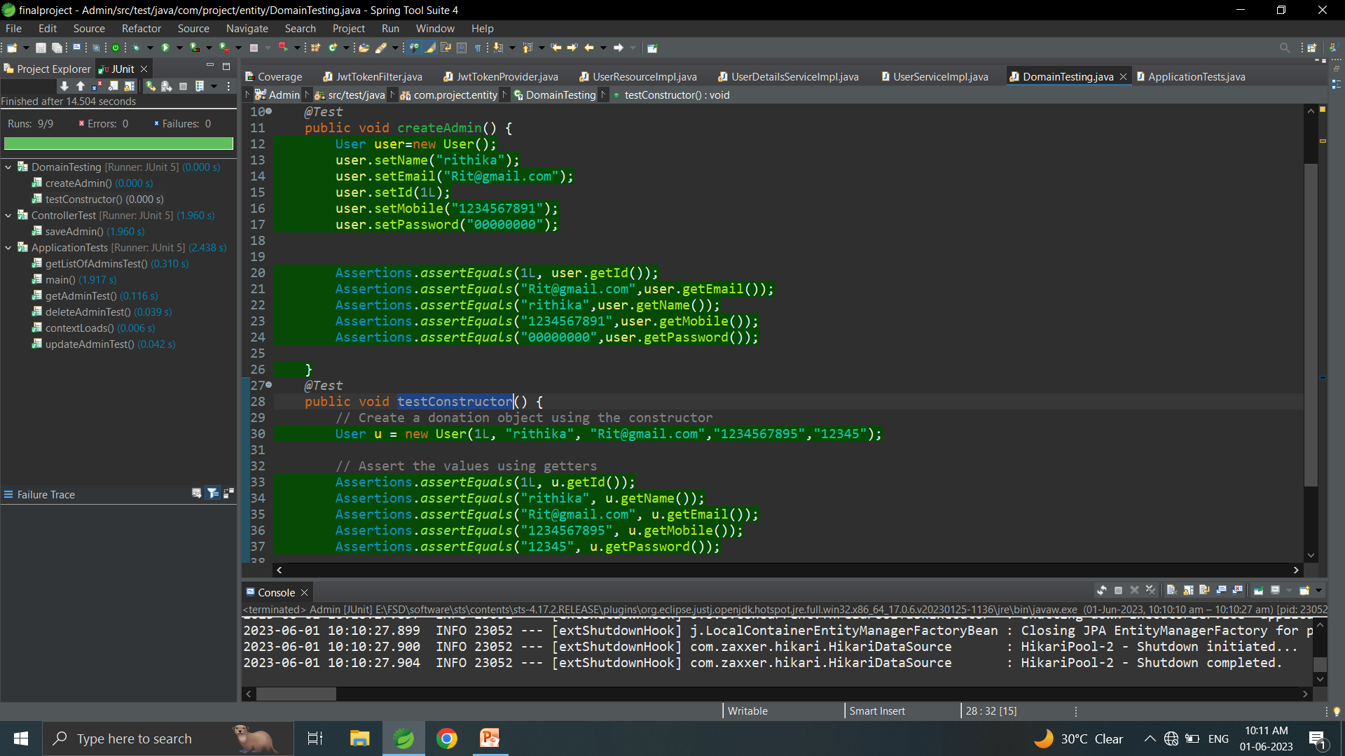
ADMIN MICROSERVICE TESTING
Total testcases : 9
Testcases passed : 9
Testcase:
To find by ID
To test constructors
Code:

Slide 13
CODE COVERAGE
USING ECLEMMA
Codeproblem Microservice

Slide 14
CODE COVERAGE
USING ECLEMMA
Student Microservice

Slide 15
CODE COVERAGE
USING ECLEMMA
Faculty Microservice

Slide 16
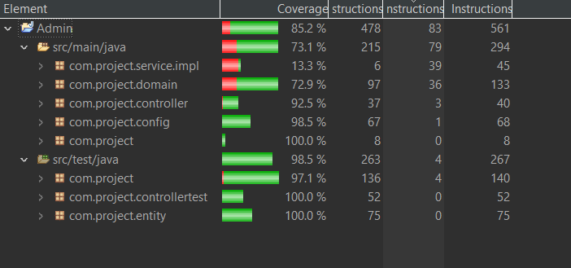
CODE COVERAGE
USING ECLEMMA
Admin Microservice

Slide 17
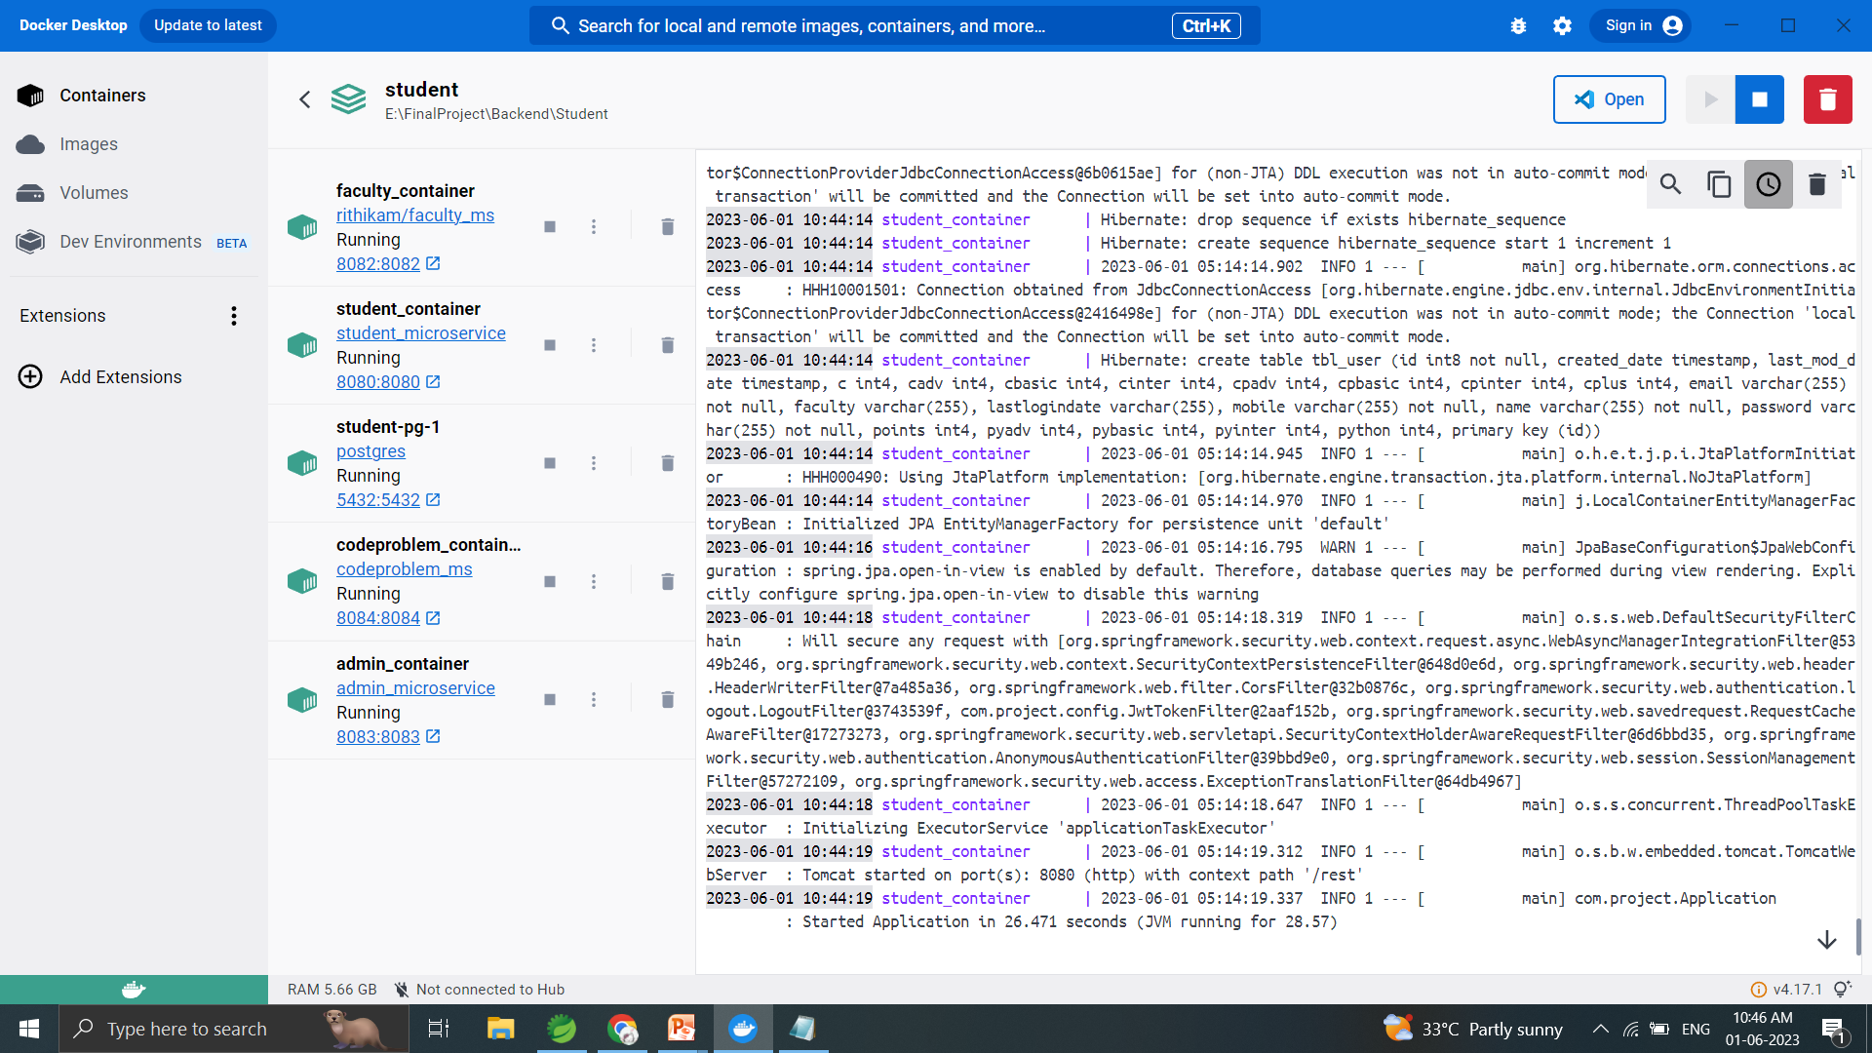
DEPLOYMENT IN DOCKER
Creating a network and running all the microservices docker images in the docker container with database PostgreSQL image.

Slide 18
CONCLUSION
Therefore, the PTU coding and monitoring platform provides a way for the PTU students to practice coding and improve their problem solving skills .
It also enables the faculty to monitor their students with their performance.

Slide 19
FUTURE ENHANCEMENT
The platform will be expanded to include a other programming languages
Facultys can post assessments to their students
Testcases will be increased for every code problems
Report Generation for individual student will be implemented

Slide 20
THANK YOU
DONE BY
RITHIKA .M (21CS418)
MCA II- year

